Slide 1
College Enrollment, Graduation, & Employment
Aparna, Brandi, and Carter

Slide 2
Motivation and Summary
Goal:
Our project goal is to compare enrollment and completion rates to employment in the US over time.
Key Questions:
Is there a relation between unemployment rate and enrollment or completion rates?
As employment rates decrease, do enrollment rates increase in response?
Can we predict enrollment rates based on current economic trends?
Findings:
We were able to visualize a correlation between enrollment and unemployment rates over time.
Similarly, we’re able to see a relationship between enrollment and completion rates.
We would need more data than what is available to determine cause-and-effect relationship and/or a predictive trend.

Slide 3
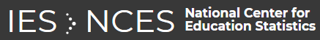
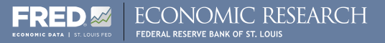
Questions & Data
Based on our questions, what types of data do we need to locate?
Economic data, including unemployment rates
Educational data, including enrollment and completion trends
Data Sources:
National Center for Educational Statistics
Federal Reserve Economic Data

Slide 4

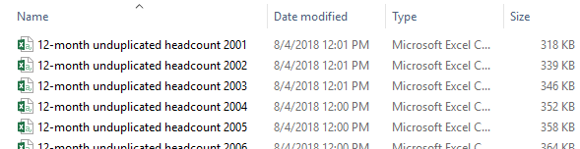
Data Cleanup & Exploration - NCES
NCES Exploration
Custom data files
User-friendly site
NCES Data Files Obtained
Separate files, per year
2001-2017 for enrollment, 2005-2017 for completions
Merged using “copy*combine.csv” command line
Cleanup
Removed extraneous columns
Removed rows with missing data
Problems
Many holes in the completion data

Slide 5
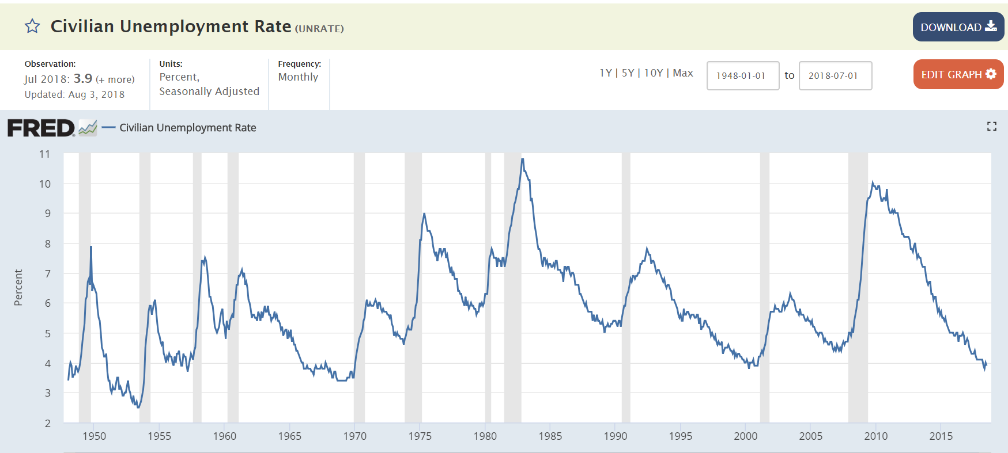
Data Cleanup & Exploration - FRED
FRED Exploration
Economic data
>500k data series
FRED Data Files Obtained
Monthly unemployment (2000-2018)
Monthly labor force participation (2000-2018)
Weekly unemployment claims (2000-2018)
Cleanup
Removed extraneous columns
Averaged data annually to match NCES data
Problems
Different frequency of observations than NCES data

Slide 6
Data Analysis
Group data by year
Calculated the average Rate of Change
Visualized the data via MatPlotLib line, bar, and pie charts
Layered the visuals to look for correlations
Used excel to look for regression values

Slide 7
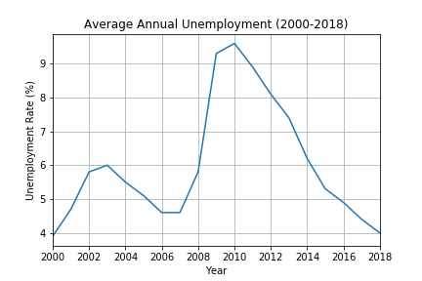
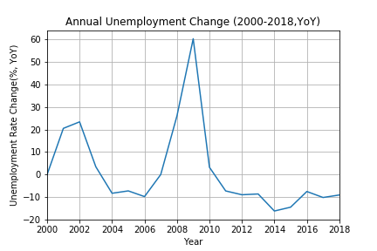
Unemployment Data

Slide 8
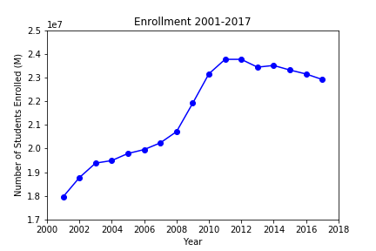
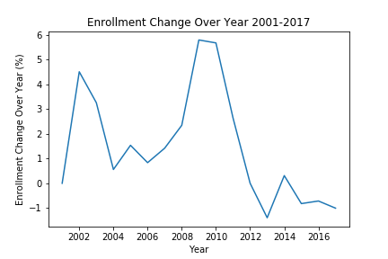
Enrollment Data

Slide 9
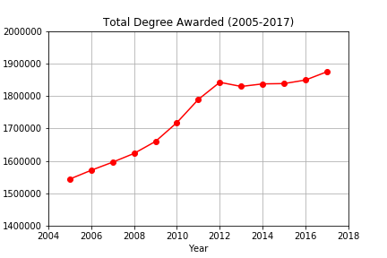
Trend in Degrees Awarded

Slide 10
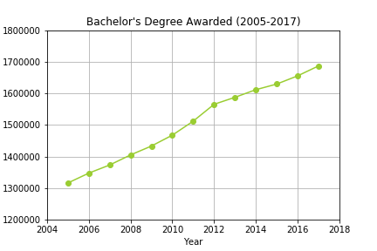
Trend in Degrees Awarded

Slide 11
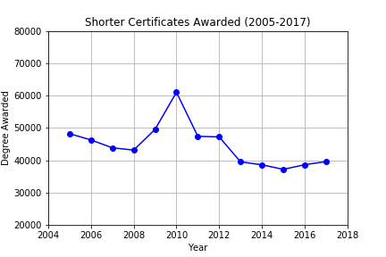
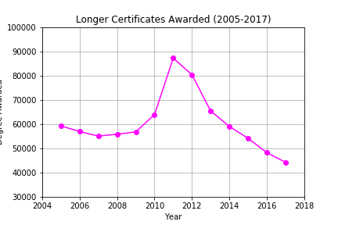
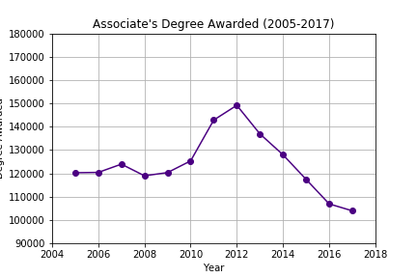
Trend in Degree Types Awarded
Short Term - 2010 peak
Longer Term - 2011 peak
Associate’s Degree - 2012 peak
Unemployment - 2010 peak

Slide 12
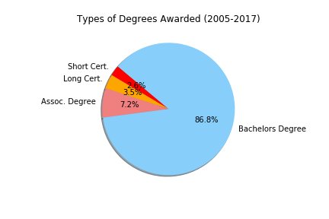

Slide 13
Findings

Slide 14
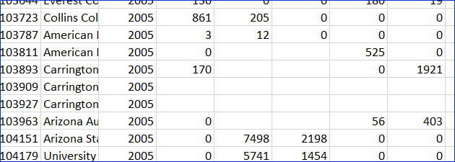
Post Mortem
Difficulties
Limited data
Dangers of using dropna
With .dropna, deleted ~11,000 rows!
Convert NaN to ‘0’ value instead.
Snags with visualizing the data
Next Steps
How the number of degrees awarded effect the economy
Compare textbook sales to enrollment rates and total institution counts

Slide 15
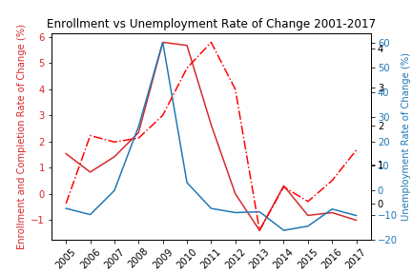
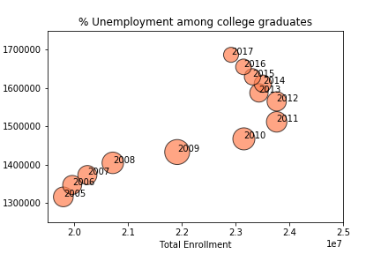
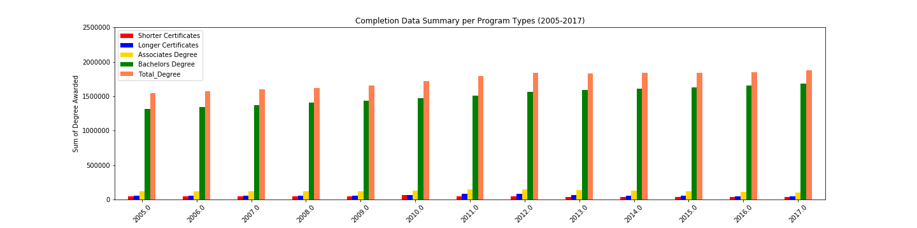
Troubles Visualizing the Data

Slide 16
Questions?

